Slide 1



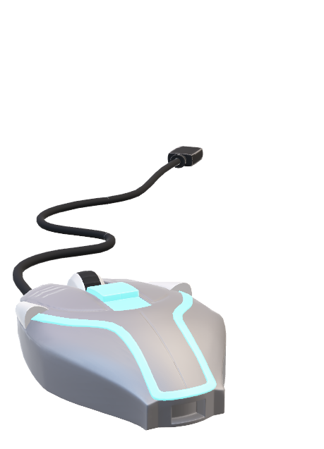

Python Lab
Name : Amresh Bhuyan
Roll no : 22BTCSE06
Section : B
Semester : IV

Slide 2
INDEX
SL. No. | Assignment No | Date of Practical | Date of Submission | Page No. | Remarks & Signature
01
02
03
04
05
06
07
08
09
10
11
12

